Slide 1



Big Ideas of Science
Adapted from NZASE regional workshops 2019
Please click here – turn on your sound

Slide 2


NZASE 2019 Regional Workshop Podcast Series: #3 Big Ideas of Science
Sabina Cleary
sabina@kahaeducation.co.nz
This series of podcast works through the NZASE 2019 Regional Workshop activities
Useful with a team of teachers or for yourself
Presenters are Sabina Cleary and Carmen Kenton.
Carmen Kenton
carmen@kahaeducation.co.nz
Notes:
Kia ora koutou,
Nau mai, Haere mai
Hello everyone and welcome
This is the 3rd of 10 podcasts relating to the activities covered in the NZASE 2019 Regional Workshops
Nō Ōtautahi āhau
E mahi ana mo Kaha Education
Ko Carmen Kenton toku ingoa
I’m from Christchurch
I work for Kaha Education
My name is Carmen Kenton
This podcast looks at the Big Ideas

Slide 3


Files used in this podcast:
Please download these file to use during this podcast
Big Ideas Instructions
Big Ideas Info
Big Ideas Progression Cards
3-2-1 BIs
Plus you will need access to a copy of the New Zealand Curriculum - http://nzcurriculum.tki.org.nz/The-New-Zealand-Curriculum

Slide 4
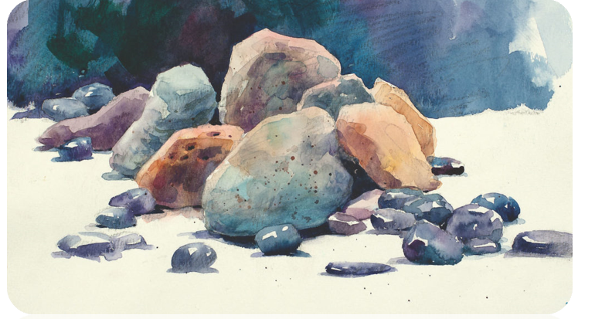
What are the Big Ideas of Science?
There are 10 major content ideas and 4 ideas of how science works that a research group in the E.U. developed.
For this podcast, we will focus on the 10 content ideas.
Harlen, W. (Ed.). (2015). Working with the big ideas of science education. Global Network of Science Academies (IAP) Science Education Programme: Trieste, Italy.

Slide 5
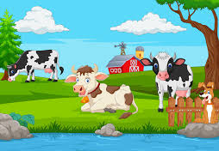
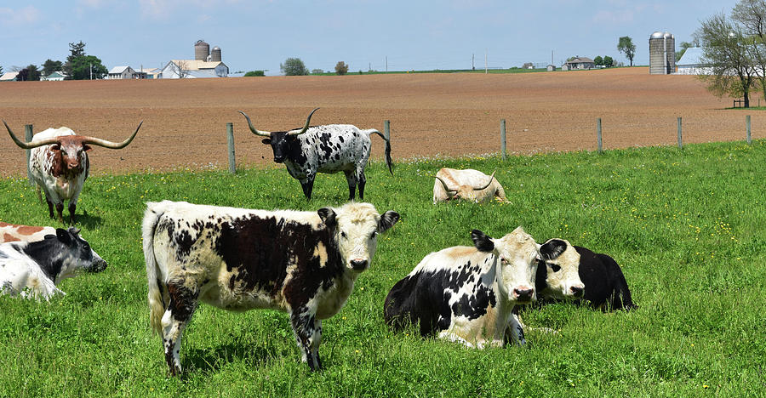
Something to consider…
Traditionally younger students get a simplified or dumbed-down version of a science idea
Traditionally older students get a more sophisticated version of a science idea
This can lead to:
Misconceptions
Struggle to relate the idea to the real world
Notes:
Misconceptions that are unknown to the teacher are particularly problematic during future learning experiences
When a simplified or dumbed-down version of a science idea is used as a learning experience, the students struggle to relate the ideas to the real world because it looks so different to their real world experiences

Slide 6
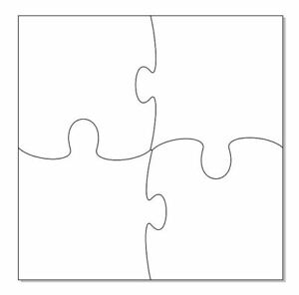
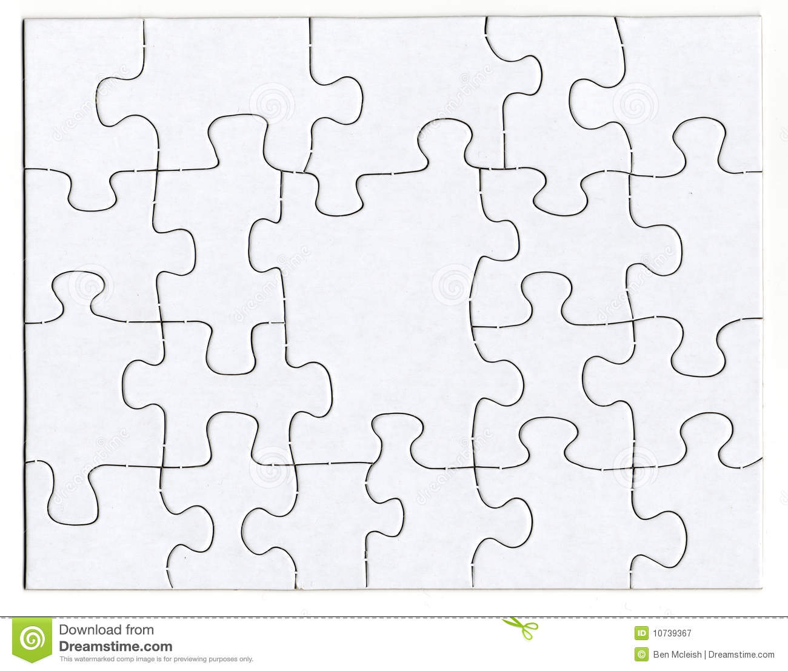
The Big Ideas of Science leads us to think about science ideas in a different way; a ‘puzzle’ metaphor helps explain this…
Younger students get the same big picture and have fewer puzzle pieces to make that whole picture – each puzzle piece represents an understanding of a part of the science idea
Older students get the same big picture but have more puzzle pieces to make that picture – sometimes their puzzle pieces aren’t the same size
Notes:
Each puzzle piece represents an understanding of a part of the science idea being explored.
Some puzzle pieces may be bigger than others indicating the sophistication of understanding with larger pieces showing a less sophisticated understanding of that part and smaller pieces representing a high sophistication of that part of the science ideas in the context.
It is worth noting that I wouldn’t automatically transfer a student’s understanding of an idea to a different context that uses the same idea. I would seek to test that understanding in a formative way first. This is because understanding is often dependent on context, pedagogy used, and other people participating in the learning experience – both teachers and peers

Slide 7
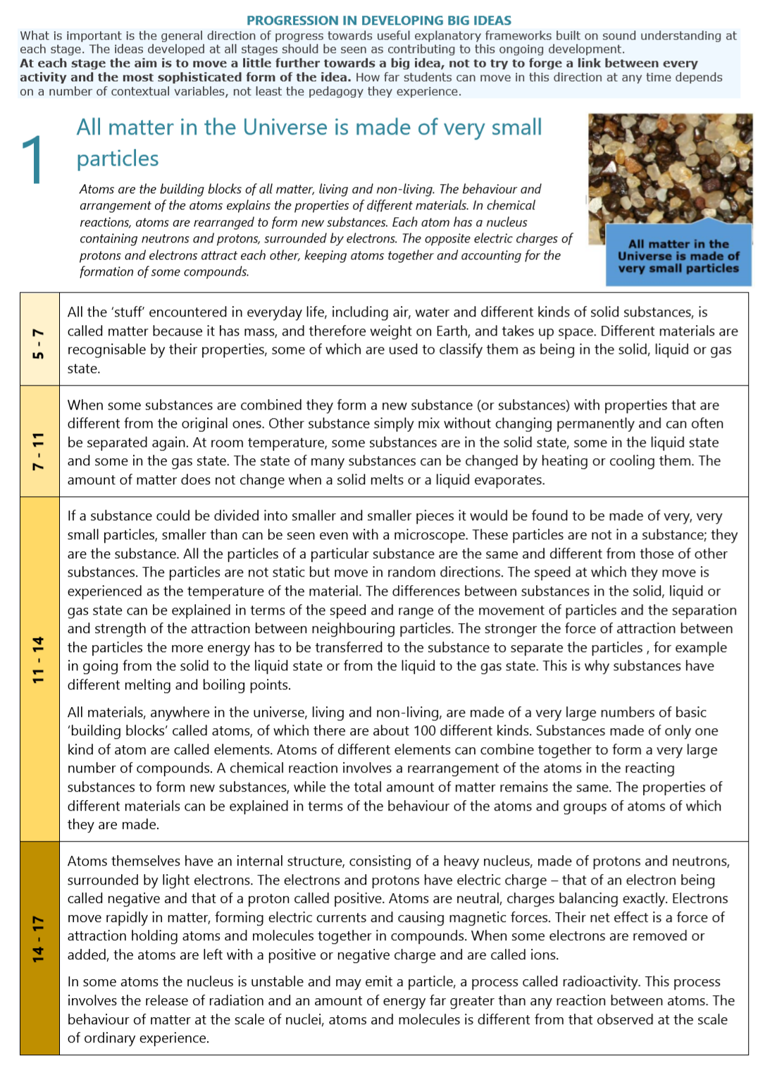
Navigating the Big Idea card
The title and description of the big idea
The age of students where they are likely capable of understanding this level of sophistication
A progressions of understanding developed in the student over their years at school; becoming more sophisticated as students get older
Notes:
Navigating the Big Ideas Progression Cards

Slide 8
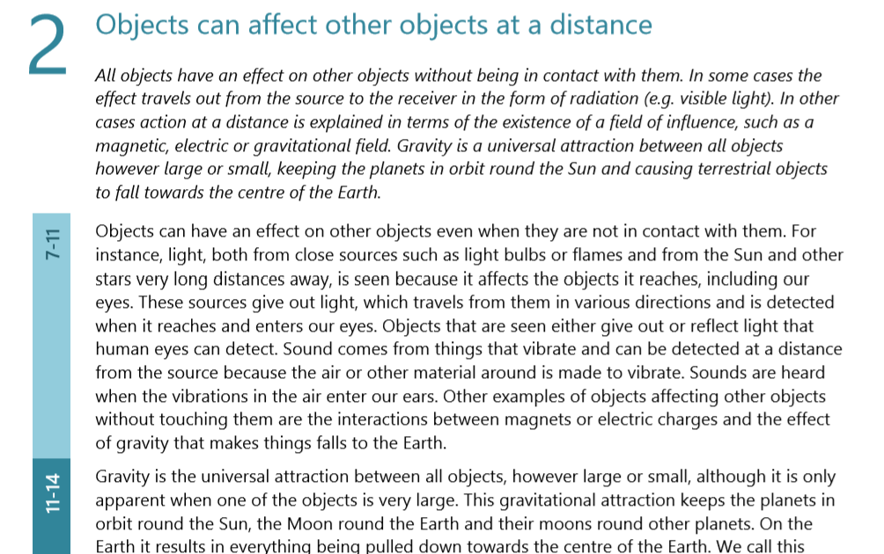
Not all Big Ideas have a description of progress at years 5-7 – most students in this age group were not capable of understanding this idea yet.
Notes:
This Big Idea has no description of progress at ages 5-7.
We recommend that you allow students to observe differences, similarities, and patterns in experiences rather than explaining the effect to them.
As always, there may be students from time to time whose understanding falls outside the suggested age group. We’ve found that having all the progression information on one page helps teachers to meet the learning needs of all students in their class whether their understanding is more or less sophisticated than the description in the suggested age group.

Slide 9
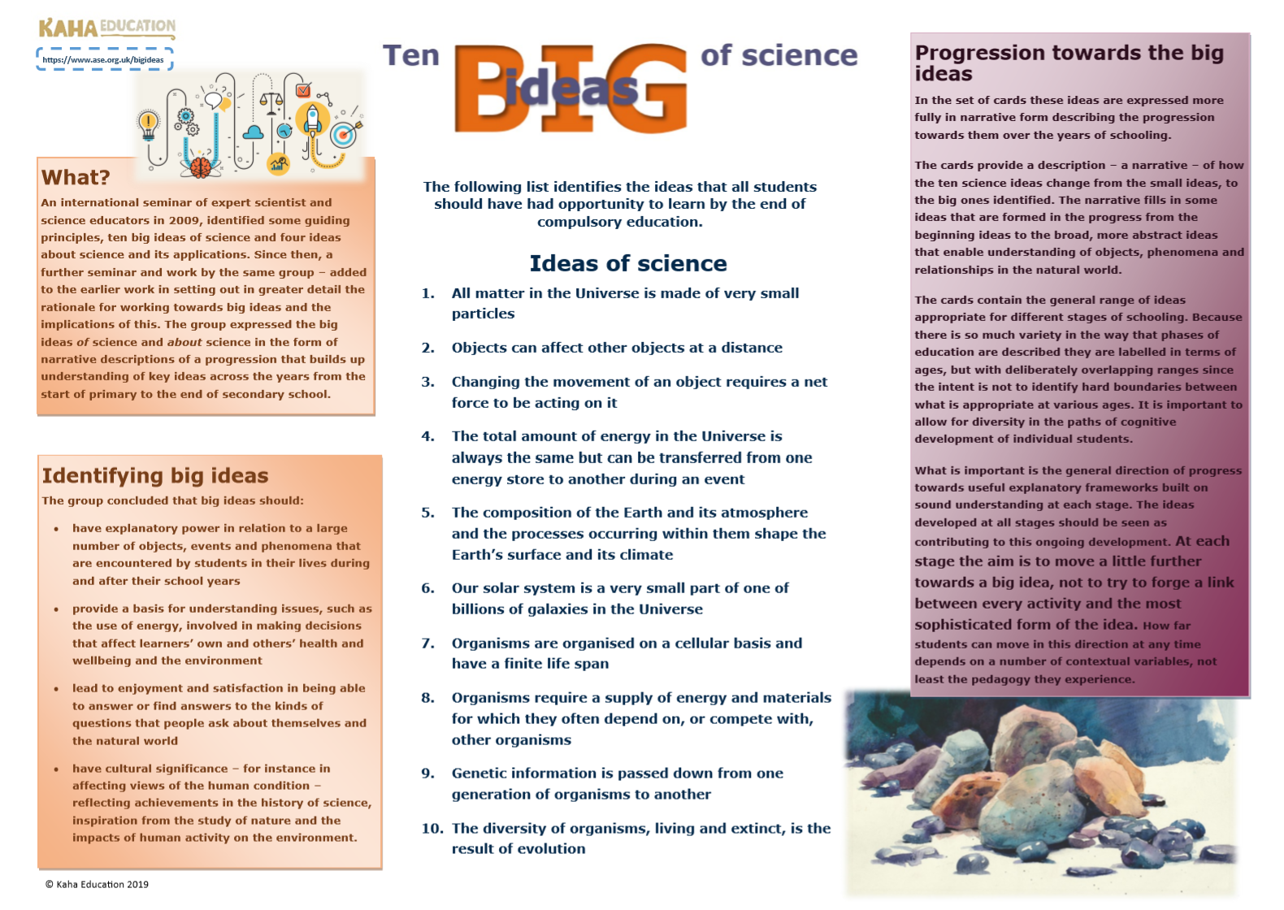
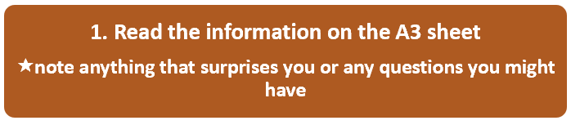
Notes:
Use the Big Ideas Info and the Big Ideas Instructions files
Take the time to read through the information on the page and complete instruction 1
What questions did you have?

Slide 10
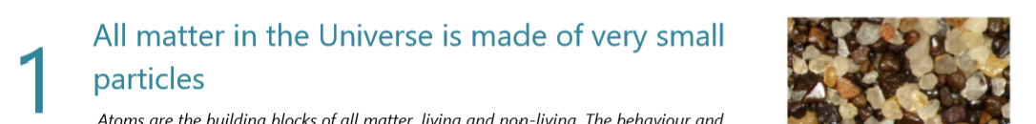
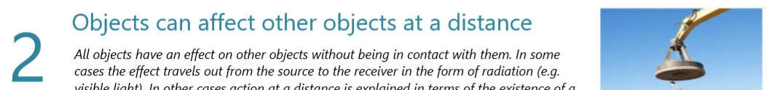
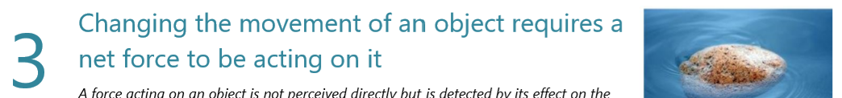
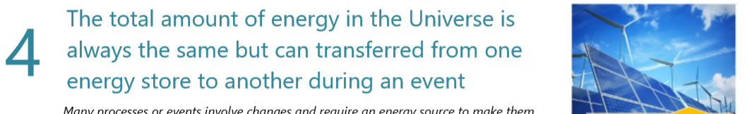
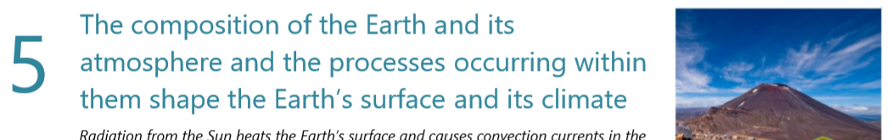
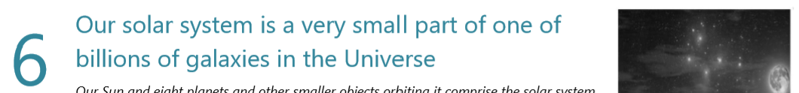
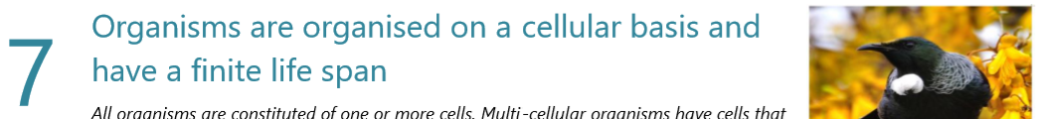
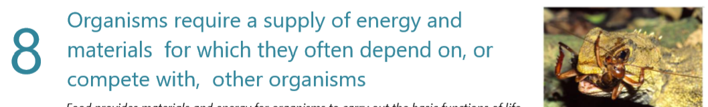
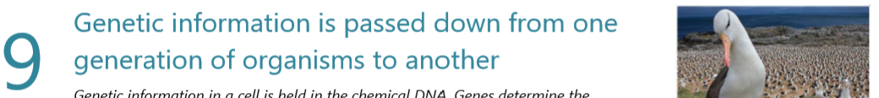
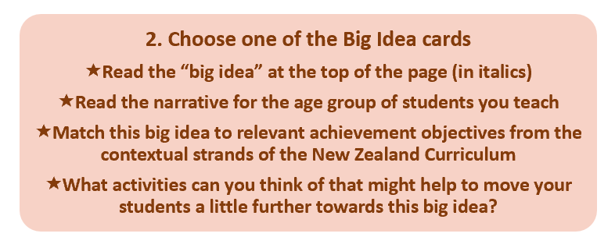


Slide 11

Complete the summary sheet. You could discuss this with colleagues:
3 key points
  2 interesting things
    1 question you have
Notes:
Use the 3-2-1 BIs template to reflect on your learning in this podcast.
We recommend that you complete this reflection template from your own point of view, rather than the group’s point of view.
You may like to discuss the Big Ideas with a colleague. You may like to include this reflection in your appraisal documentation – It’s up to you

Slide 12

References
Harlen, W. (Ed.). (2010). Principles and big ideas of science education. Global Network of Science Academies (IAP) Science Education Programme: Trieste, Italy.
Harlen, W. (Ed.). (2015). Working with the big ideas of science education. Global Network of Science Academies (IAP) Science Education Programme: Trieste, Italy.

Slide 13
Contact us:
Sabina Cleary
sabina@kahaeducation.co.nz
If you wish to contact us, please do. We’d love to hear your feedback, thoughts, questions, ideas, and experiences.
Carmen Kenton
carmen@kahaeducation.co.nz

