Slide 1



Progression - Adapted from NZASE regional workshops 2019
Please click here – turn on your sound
This Photo by Unknown Author is licensed under CC BY-NC-ND

Slide 2
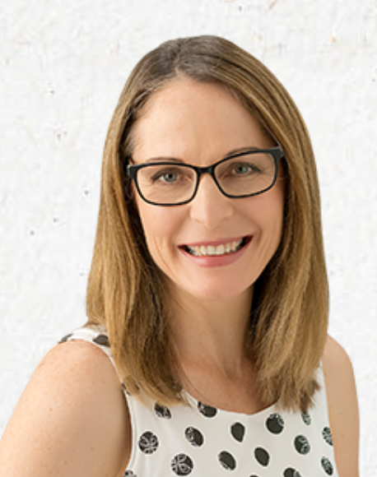
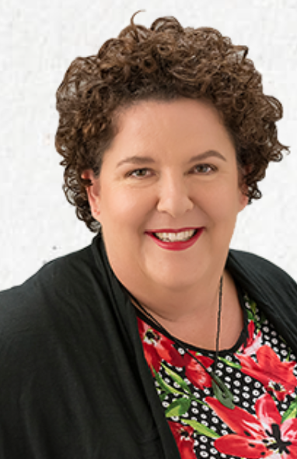
NZASE Podcast Series: Getting Started in Science - Progression
Sabina Cleary
sabina@kahaeducation.co.nz
The NZASE Podcast Series is one way we share ideas, resources, and research about science teaching and learning in New Zealand.
Useful with a team of teachers or for yourself
Presenters are Sabina Cleary and Carmen Kenton.
Carmen Kenton
carmen@kahaeducation.co.nz
Notes:
Kia ora koutou,
Nau mai, Haere mai
Hello everyone and welcome
This is the 5th podcast relating to the activities covered in the NZASE 2019 Regional Workshops
Nō Ōtautahi āhau
E mahi ana mo Kaha Education
Ko Carmen Kenton toku ingoa
I’m from Christchurch
I work for Kaha Education
My name is Carmen Kenton
This podcast explores progression in science

Slide 3


Files used in this podcast:
Progression some things to think about
Progression Science Capabilities TKI
NMSSA Science Capability Scale
Please download these files to use during this podcast

Slide 4

Thinking about progression… 1/3
Read the document Progression some things to think about
What is the most significant point you gained from this page?
Discuss this in pairs

Slide 5

… 2/3
2. Have a look at ONE page of the Progression Science Capabilities TKI document
What is one important aspect of task design for your students (at their curriculum level)?

Slide 6
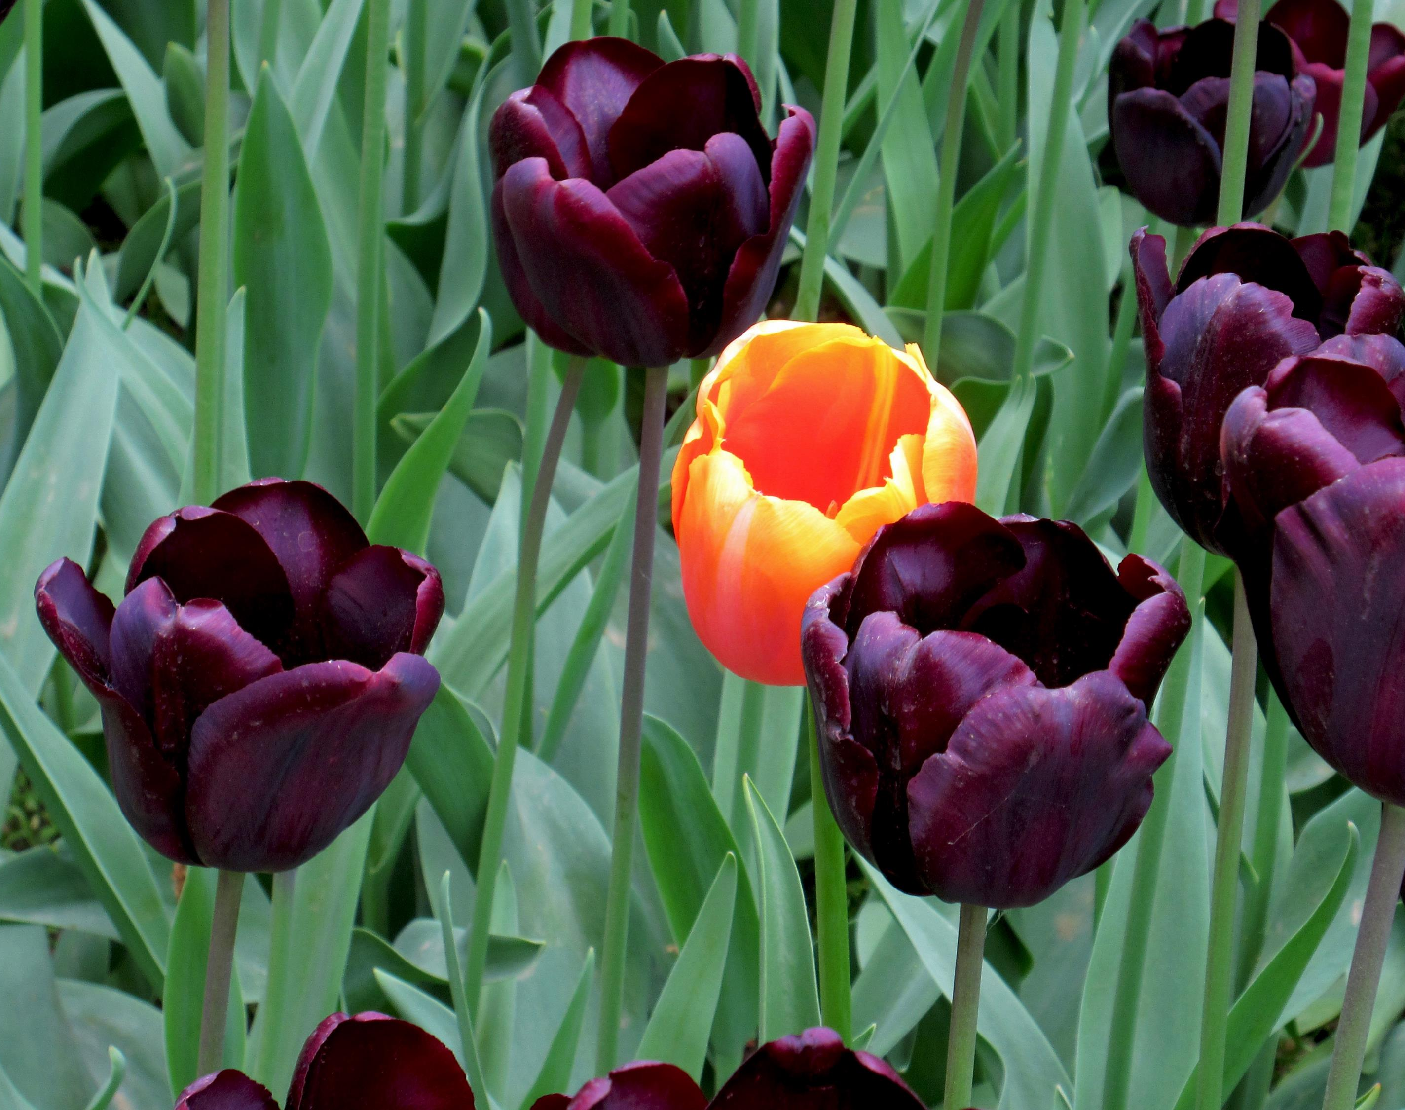
… 3/3
3. Have a look at the NMSSA Science Capabilities Scale document
How is this similar or different to the ways in which you have assessed your students’ science understandings?

Slide 7
Next steps…
You might like to….
Collect evidence from your students and create a continuum of progression with respect to the Nature of Science.
  What does the evidence show you?
  What are each of these student’s next steps? (You could choose 4-6 students for this task, or more)
  What are your next steps as a teacher?
This Photo by Unknown Author is licensed under CC BY-NC-ND

Slide 8


Readings & Resources
National monitoring study of student achievement 2017 Science publications
Key Findings https://nmssa.otago.ac.nz/reports/2017/2017_NMSSA_SCIENCE.pdf
Insights for teachers https://nmssa.otago.ac.nz/insights/INSIGHTS_Science_2017.pdf
Ally Bull, 2015, Capabilities for living and lifelong learning: What’s science got to do with it?
https://www.nzcer.org.nz/research/publications/capabilities-living-and-lifelong-learning-whats-science-got-do-it
NZCER workshops available – twice in the last 18 months, they have run workshops on the NMSSA study and findings https://www.nzcer.org.nz/workshops

Slide 9
Contact us:
Sabina Cleary
sabina@kahaeducation.co.nz
If you wish to contact us, please do. We’d love to hear your feedback, thoughts, questions, ideas, and experiences.
Carmen Kenton
carmen@kahaeducation.co.nz

